Slide 1
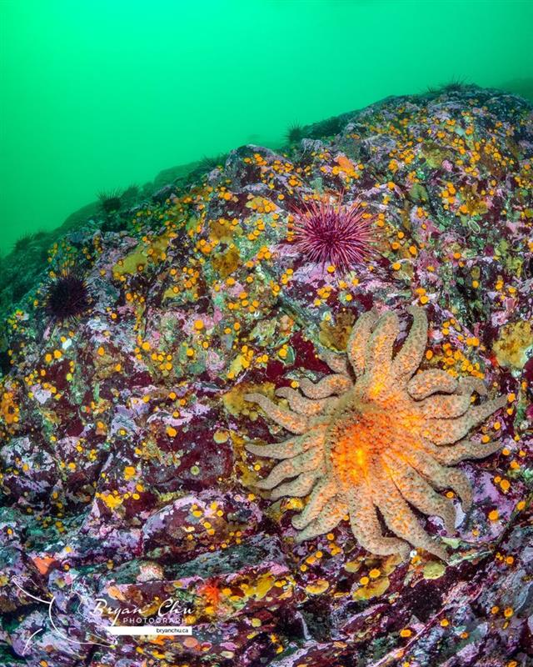
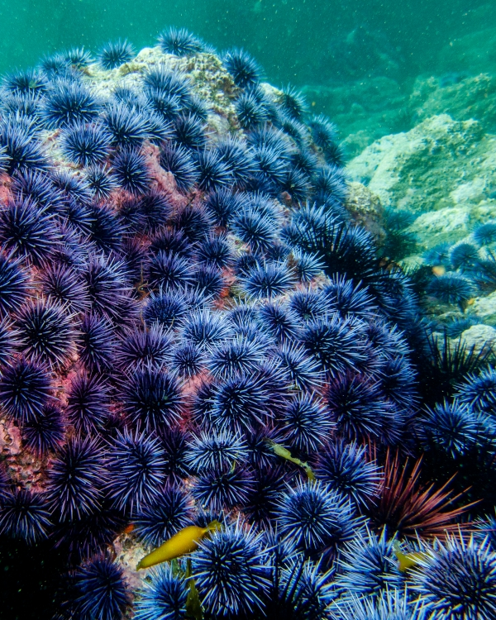
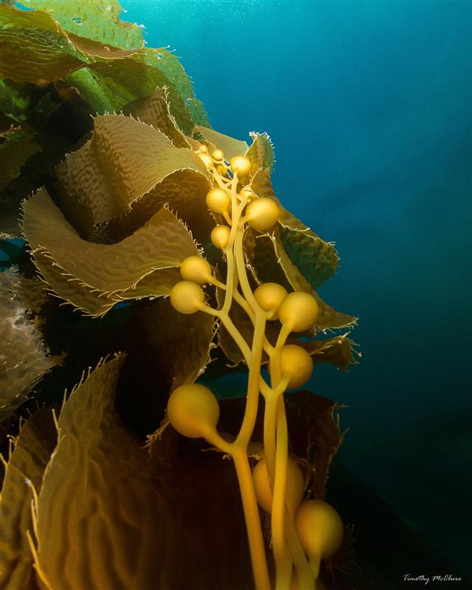
Differential Effects of Trophic Cascades in Marine Protected Areas at Channel Islands National Park
Kelp Forest Monitoring Program

Slide 2
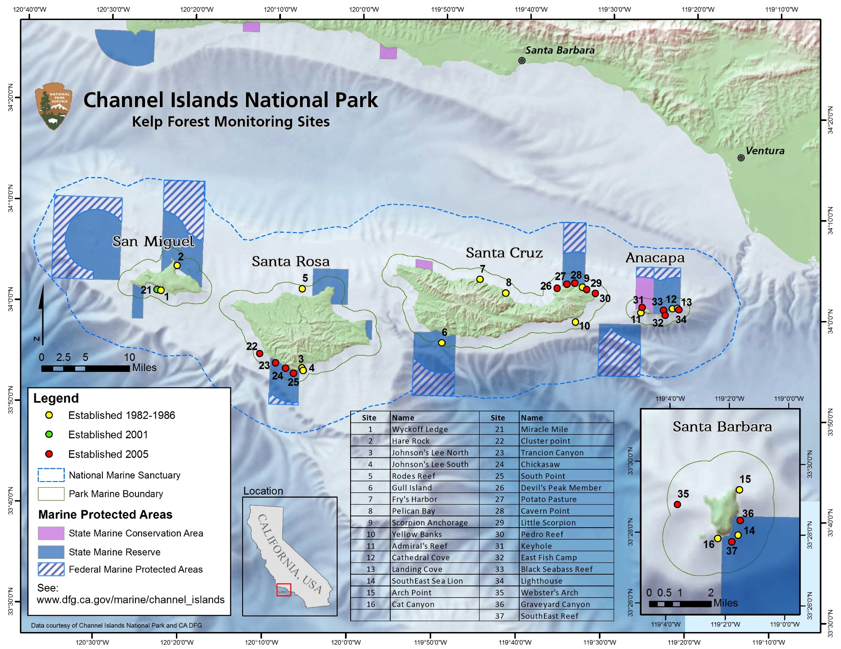

Slide 3
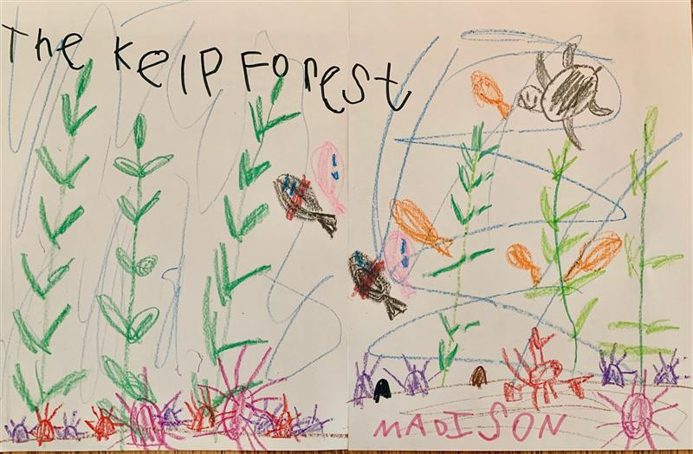
What ecological processes regulate community structure in kelp forests?
Notes:
Going to introduce the three species we’re going to show you today, and use them as an example to explain trophic cascades

Slide 4
Pycnopodia helianthoides (sunflower star)
Notes:
Brief natural history on the predator/prey/resource relationship between Pycnopodia, Strongylocentrotus, and Macrocystis

Slide 5
Strongylocentrotus purpuratus (purple urchin)
Notes:
Brief natural history on the predator/prey/resource relationship between Pycnopodia, Strongylocentrotus, and Macrocystis

Slide 6
Macrocystis pyrifera (giant kelp)
Notes:
Brief natural history on the predator/prey/resource relationship between Pycnopodia, Strongylocentrotus, and Macrocystis

Slide 7
Sunflower star
Purple urchin
Giant kelp
Direct Effect (-)
Trophic Cascade
Indirect Effect (+)
Notes:
Explain trophic cascades using this example – idea is that the “cascade” is this indirect effect from predators onto resource - stars onto kelp

Slide 8
Sunflower star
Purple urchin
Giant kelp
Direct Effect (-)
Trophic Cascade
Indirect Effect (+)
Notes:
Explain trophic cascades using this example – idea is that the “cascade” is this indirect effect from predators onto resource - stars onto kelp

Slide 9
Sunflower star
Purple urchin
Giant kelp
Direct Effect (-)
Trophic Cascade
Indirect Effect (+)
Notes:
Explain trophic cascades using this example – idea is that the “cascade” is this indirect effect from predators onto resource - stars onto kelp

Slide 10
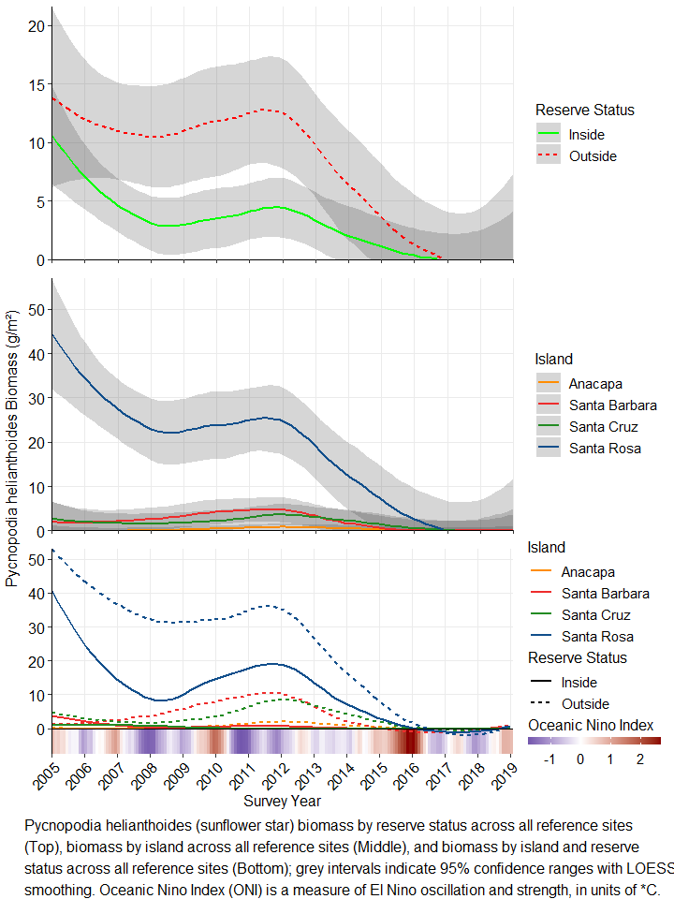

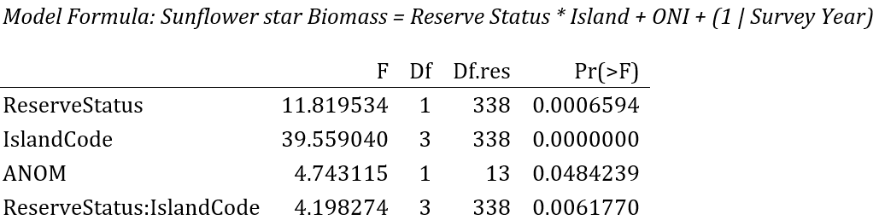
Sunflower Star Biomass
Statistically significant effects of reserve, island, and their interaction
Cold water urchin predator
Blob and Sea Star Wasting Disease in 2013 -> population collapse
Notes:
Fill in notes here
Dan

Slide 11
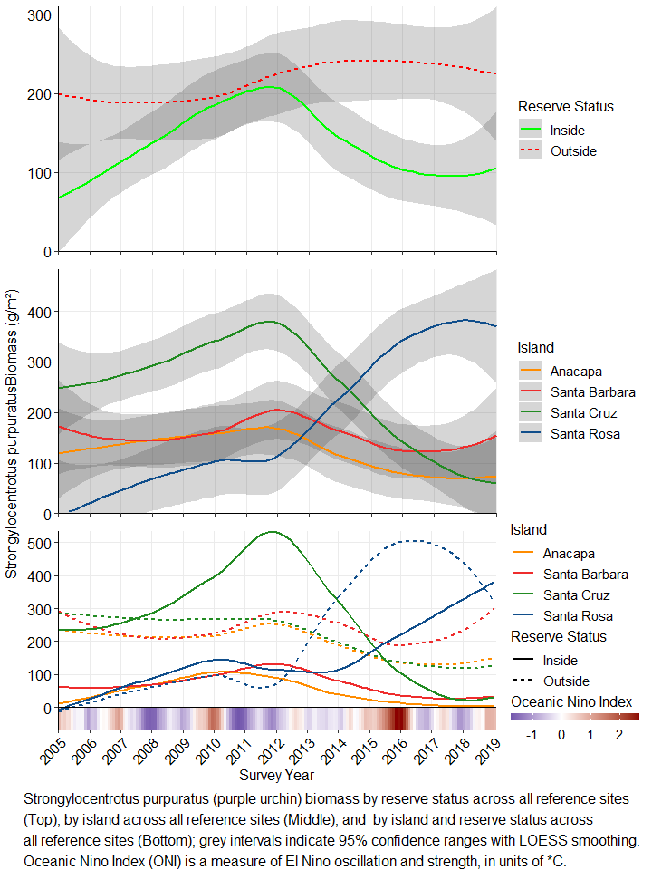
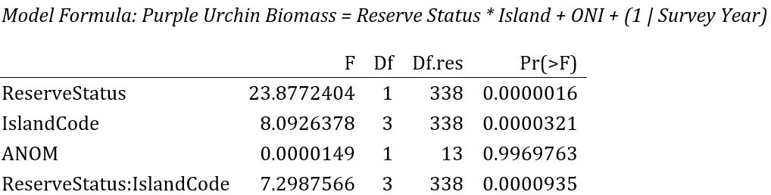
Purple Urchin Biomass
Significant effects of Reserve Status, Island Code, and their interaction
Increase at SRI in biomass outside of MPAs post-blob, decreases at warmer islands (SCI, ANI, SBI)
Increase in biomass greatest at SRI outside MPAs
Notes:
Lindsay

Slide 12
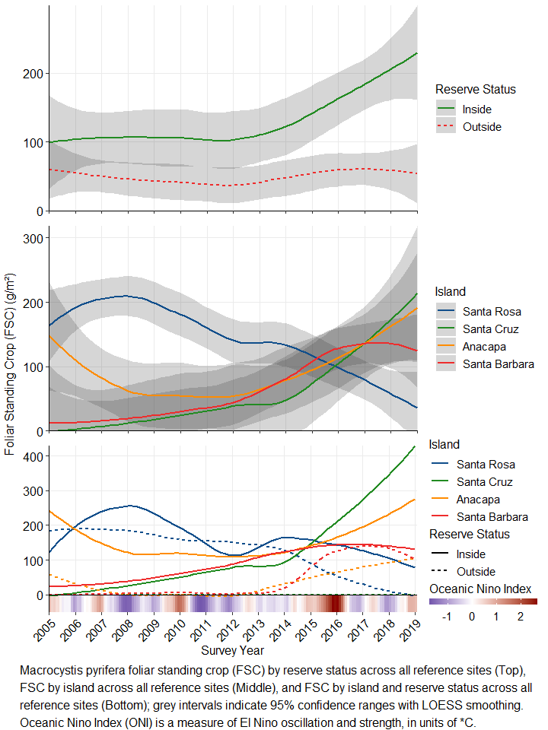

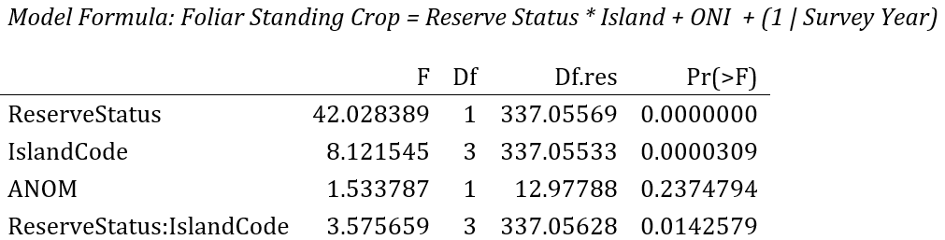
Giant Kelp Biomass
Significant effects of Reserve Status, Island Code, and their interaction
Recent significant increase in kelp inside MPAs
Kelp biomass generally similar between islands, except previously higher at SR
Notes:
Cullen
Any anecdotal examples that the park crew will understand ie green line at edge of Scorpion MPA

Slide 13
Conclusions
Effects via Trophic Cascades on MPAs are apparent
Outside MPAs:
sunflower stars were more abundant prior to their decline (particularly at SRI)
purple urchin biomass has since increased (particularly at SRI)
kelp biomass has not increased in general, and has decreased at SRI
Inside MPAs:
Sunflower stars declined
Purple urchin biomass at SRI has not increased at the same rate as outside MPAs
Kelp inside MPAs at SRI has not decreased at the same rate as outside MPAs
Other urchin predators:
Urchin biomass at warmer islands (SCI, ANI, SBI) have decreased inside MPAs, kelp biomass has increased inside MPAs
Fishing protections for California sheephead and California spiny lobster
Notes:
Tim

Slide 14
Conclusions
Effects via Trophic Cascades on MPAs are apparent
Outside MPAs:
sunflower stars were more abundant prior to their decline (particularly at SRI)
purple urchin biomass has since increased (particularly at SRI)
kelp biomass has not increased in general, and has decreased at SRI
Inside MPAs:
Sunflower stars declined
Purple urchin biomass at SRI has not increased at the same rate as outside MPAs
Kelp inside MPAs at SRI has not decreased at the same rate as outside MPAs
Other urchin predators:
Urchin biomass at warmer islands (SCI, ANI, SBI) have decreased inside MPAs, kelp biomass has increased inside MPAs
Fishing protections for California sheephead and California spiny lobster
Notes:
Tim

Slide 15
Conclusions
Effects via Trophic Cascades on MPAs are apparent
Outside MPAs:
sunflower stars were more abundant prior to their decline (particularly at SRI)
purple urchin biomass has since increased (particularly at SRI)
kelp biomass has not increased in general, and has decreased at SRI
Inside MPAs:
Sunflower stars declined
Purple urchin biomass at SRI has not increased at the same rate as outside MPAs
Kelp inside MPAs at SRI has not decreased at the same rate as outside MPAs
Other urchin predators:
Urchin biomass at warmer islands (SCI, ANI, SBI) have decreased inside MPAs, kelp biomass has increased inside MPAs
Fishing protections for California sheephead and California spiny lobster
Notes:
Tim

Slide 16
Conclusions
Effects via Trophic Cascades on MPAs are apparent
Outside MPAs:
sunflower stars were more abundant prior to their decline (particularly at SRI)
purple urchin biomass has since increased (particularly at SRI)
kelp biomass has not increased in general, and has decreased at SRI
Inside MPAs:
Sunflower stars declined
Purple urchin biomass at SRI has not increased at the same rate as outside MPAs
Kelp inside MPAs at SRI has not decreased at the same rate as outside MPAs
Other urchin predators:
Urchin biomass at warmer islands (SCI, ANI, SBI) have decreased inside MPAs, kelp biomass has increased inside MPAs
Fishing protections for California sheephead and California spiny lobster
Notes:
Tim

Slide 17
Next Week: San Miguel Island Community Changes

